Slide 1


Slide 2
PROGRAMMABLE PERIPHERAL INTERFACE-8255
Features:
It is a programmable , parallel I/O device .
It has 24 I/O programmable pins like PA,PB,PC (3-8 pins).
It operate in two modes:
  BSR Mode
  I/O Mode

Slide 3
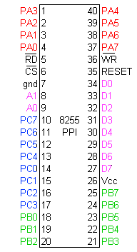
Pin Diagram

Slide 4
Function of pins:
Data bus(D₀-D₇):These are 8-bit bi-directional buses, connected to 8085 data bus for transferring data.
CS: This is Active Low signal. When it is low, then data is transfer from 8085.
Read: This is Active Low signal, when it is Low read operation will be start.
Write: This is Active Low signal, when it is Low Write operation will be start.

Slide 5
Address (A₀-A₁):This is used to select the ports. like this
A1 | A0 | Select
0 | 0 | PA
0 | 1 | PB
1 | 0 | PC
1 | 1 | Control reg.

Slide 6
RESET: This is used to reset the device. That means clear control registers.
PA₀-PA₇:It is the 8-bit bi-directional I/O pins used to send the data to peripheral or
or to receive the data from peripheral.
PB₀-PB₇:Similar to PA
PC₀-PC₇:This is also 8-bit bidirectional I/O pins. These lines are divided into two groups.
PC₀ to PC₃(Lower Groups)
PC₄ to PC₇ (Higher groups)
These two groups working in separately using 4 data’s.

Slide 7
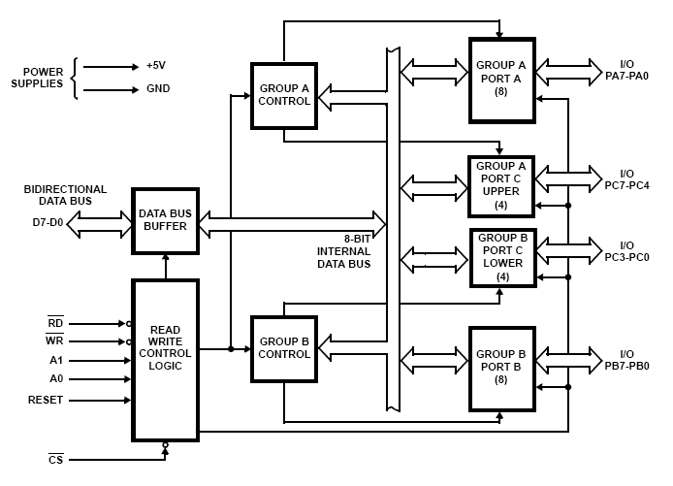
Block Diagram

Slide 8
Data Bus buffer:
It is a 8-bit bidirectional Data bus.
Used to interface between 8255 data bus with system bus.
The internal data bus and Outer pins D₀-D₇ pins are connected in internally.

Slide 9
Read/Write Control Logic:
This is getting the input signals from control bus and Address bus
Control signal are RD and WR.
Address signals are A0,A1,and CS.
8255 operation is enabled or disabled by CS.

Slide 10
Group A and Group B control:
Group A and B get the Control Signal from CPU
  and send the command to the individual control blocks.
  Group A send the control signal to port A and Port C (Upper) PC7-PC4.
Group B send the control signal to port B and Port C (Lower) PC3-PC0.
PORT A:
This is a 8-bit I/O port.
It can be programmed by mode 0 , mode 1, mode 2 .

Slide 11
PORT B:
This is a 8-bit I/O port
It can be programmed by mode 0 and mode 1.
PORT C:
This is a 8-bit I/O port
It is splitted into two parts.
It can be programmed by bit set/reset operation.

Slide 12
Operation modes:
BIT SET/RESET MODE (BSR):
The PORT C can be Set or Reset by sending OUT instruction to the CONTROL registers.
I/O MODES:
MODE 0(Simple input / Output):
In this mode , port A, port B and port C is used as individually (Simply).
Ports do not have Handshake or interrupt capability.

Slide 13
MODE 1 :(Input/output with Hand shake)
In this mode, input or output is transferred by hand shaking Signals.
Handshaking signals is used to transfer data between whose data transfer is not same.
Computer
DATA BUS
STB
ACK
Printer

Slide 14
Example:
The computer send the data to the printer large speed compared to the printer.
When computer send the data according to the printer speed at the time only, printer can accept.
If printer is not ready to accept the data then after sending the data bus , computer uses another handshaking signal to tell printer that valid data is available on the data bus.
Each port uses three lines from port C as handshake signals

Slide 15
MODE 2:bi-directional I/O data transfer:
This mode allows bidirectional data transfer over a single 8-bit data bus using handshake signals.
This feature is possible only Group A
Port A is working as 8-bit bidirectional.
PC3-PC7 is used for handshaking purpose.
The data is sent by CPU through this port , when the peripheral request it.

Slide 16
FOR BIT SET/RESET MODE:
This is bit set/reset control word format.
X X X
Don’t care
Bit select
B1
B2
D7 | D6 | D5 | D4 | D3 | D2 | D1 | D0
BIT SET/RESET
1=SET
0=RESET
0 | 1 | 2 | 3 | 4 | 5 | 6 | 7
0 | 1 | 0 | 1 | 0 | 1 | 0 | 1
0 | 0 | 1 | 1 | 0 | 0 | 1 | 1
0 | 0 | 0 | 0 | 1 | 1 | 1 | 1
BIT SET/RESET FLAG
=0 Active

Slide 17
PC0-PC7 is set or reset as per the status of D0.
A BSR word is written for each bit
Example:
PC3 is Set then control register will be 0XXX0111.
PC4 is Reset then control register will be 0XXX01000.
X is a don’t care.

Slide 18
FOR I/O MODE:
The mode format for I/O as shown in figure
D7 | D6 | D5 | D4 | D3 | D2 | D1 | D0
Group A
Port C Upper 1=Input 0=Output
Port A 1=Input 0=Output
Mode selection 00=mode 0 01=mode 1 1x=mode 2
Group B
Port C Lower 1=Input 0=Output
Port B 1=Input 0=Output
Mode selection 0=mode 0 1=mode 1
Mode set flag=1=I/O mode

Slide 19
Bit D7 is used for specifying whether word loaded in to Bit set/reset mode or I/O Mode .
D7=1= I/O Mode.
D7=0=Bit set/Reset mode.

